Slide 1
ECG BASICS 26 MAY ,2021
PART OF DESIGNING BPF FOR ECG
VLSI PROJECT
Prof. Dr. Gaurav Trivedi
Associate Professor of Electronics and Electrical Engineering, IIT Guwahati
Ms. Meenali Janveja Research Scholar IIT Guwahati

Slide 2
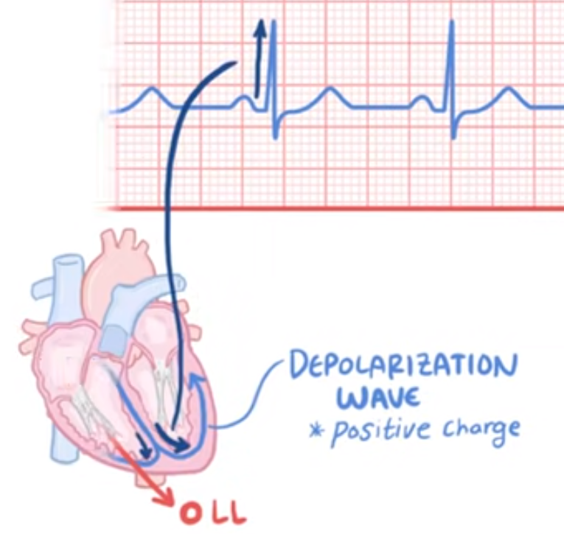
https://www.youtube.com/watch?v=xIZQRjkwV9Q
See link for clarity &notes

Slide 3
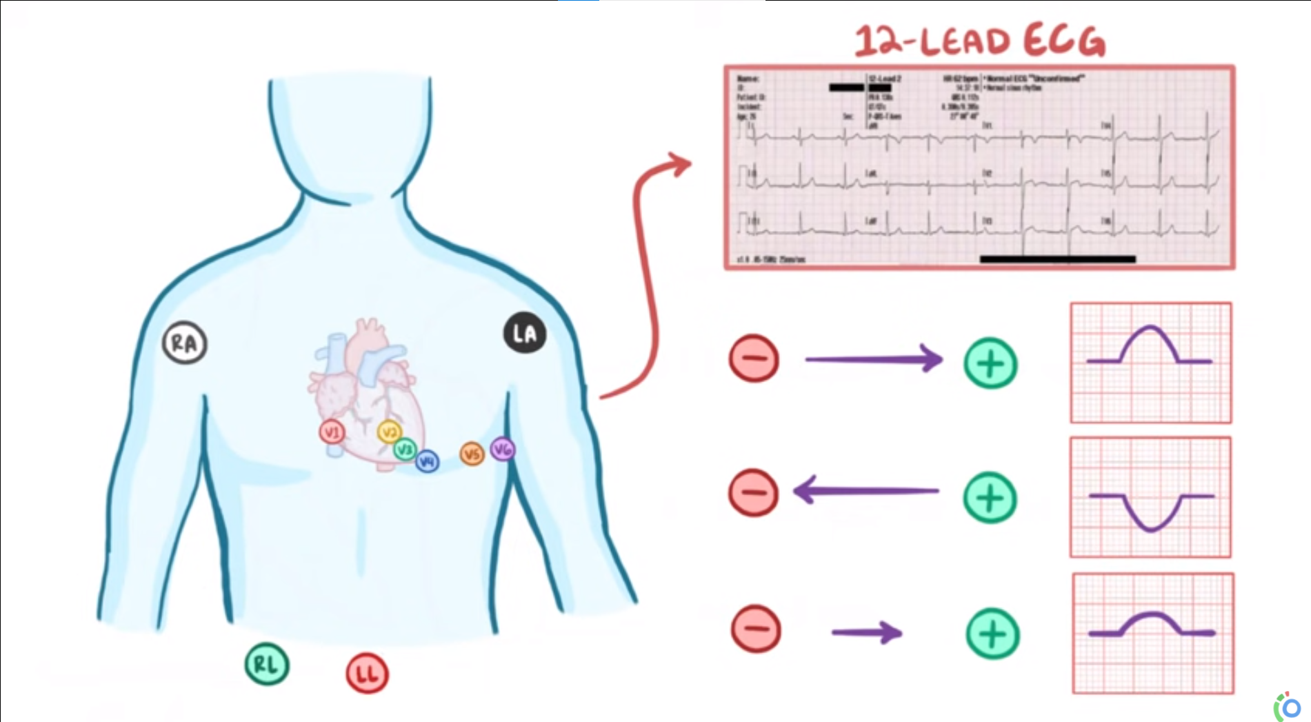

Slide 4
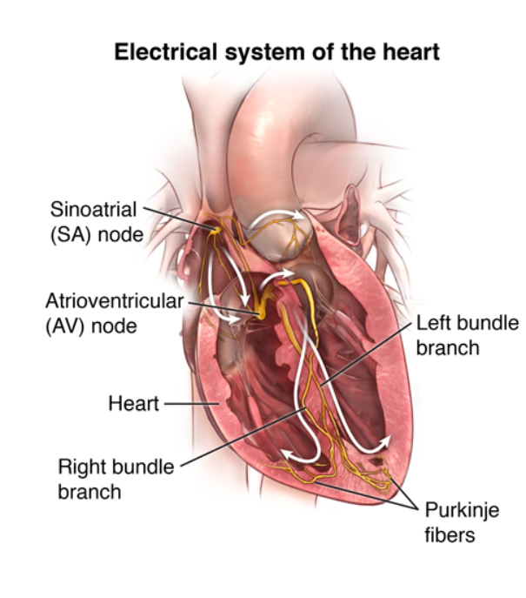
An electrical stimulus is generated by the sinus node (also called the sinoatrial node, or SA node). This is a small mass of specialized tissue located in the right upper chamber (atria) of the heart. The sinus node generates an electrical stimulus regularly, 60 to 100 times per minute under normal conditions. The atria are then activated. The electrical stimulus travels down through the conduction pathways and causes the heart's ventricles to contract and pump out blood. The 2 upper chambers of the heart (atria) are stimulated first and contract for a short period of time before the 2 lower chambers of the heart (ventricles).
The electrical impulse travels from the sinus node to the atrioventricular node (also called AV node). There, impulses are slowed down for a very short period, then continue down the conduction pathway via the bundle of His into the ventricles. The bundle of His divides into right and left pathways, called bundle branches, to stimulate the right and left ventricles.
Normally at rest, as the electrical impulse moves through the heart, the heart contracts about 60 to 100 times a minute, depending on a person's age.
Each contraction of the ventricles represents one heartbeat. The atria contract a fraction of a second before the ventricles so their blood empties into the ventricles before the ventricles contract.
Conduction of heart

Slide 5
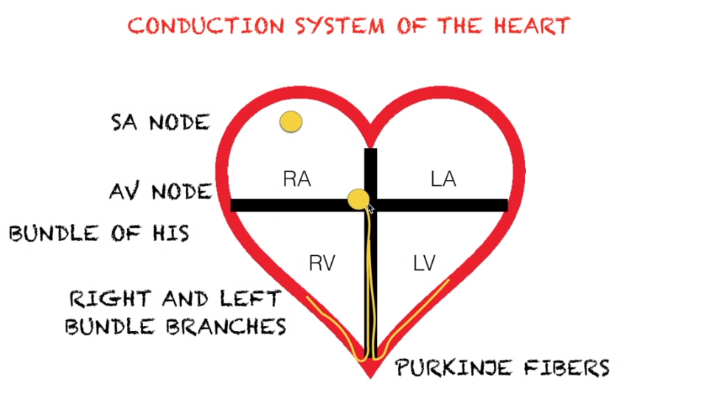
https://www.youtube.com/watch?v=FThXJUFWUrw&t=43s

Slide 6
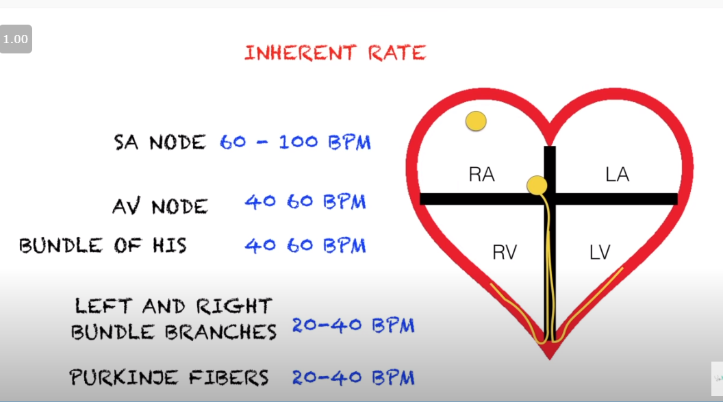

Slide 7
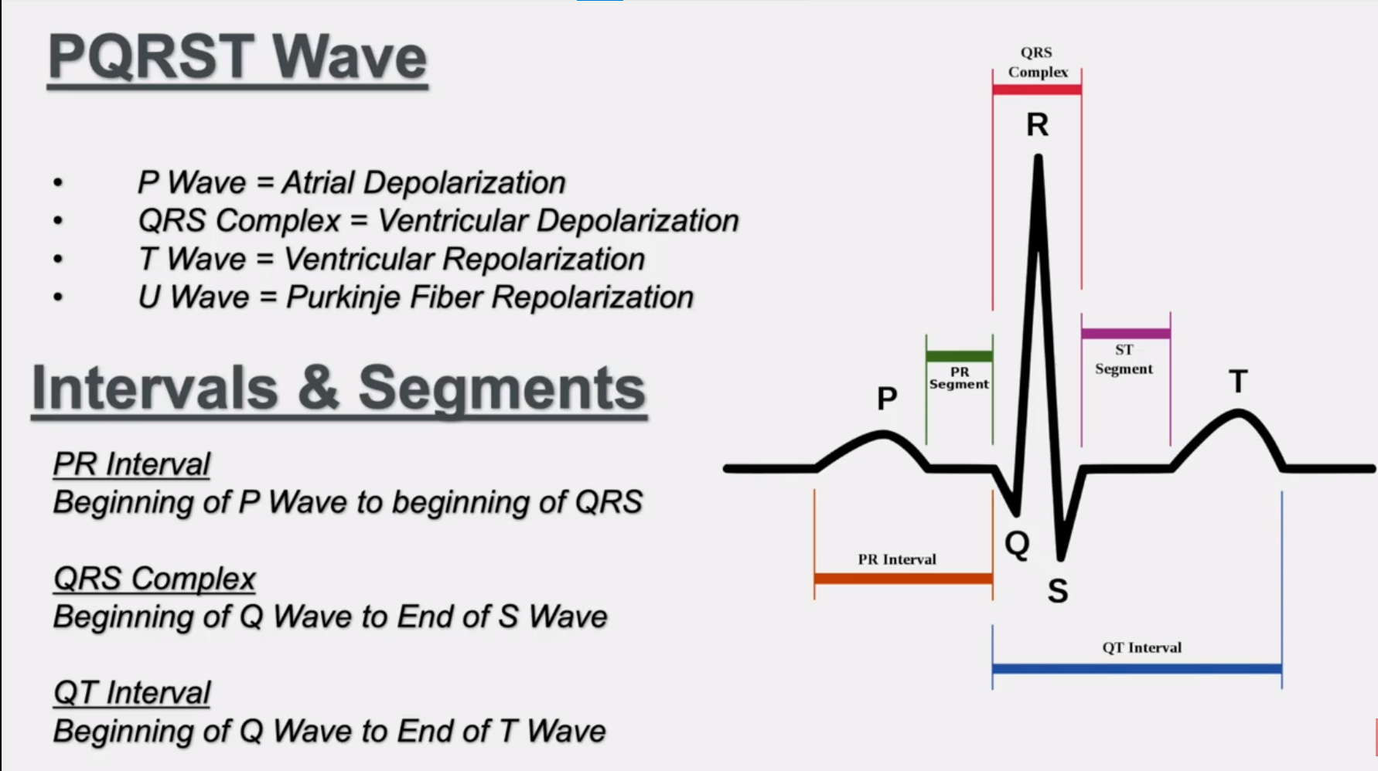

Slide 8
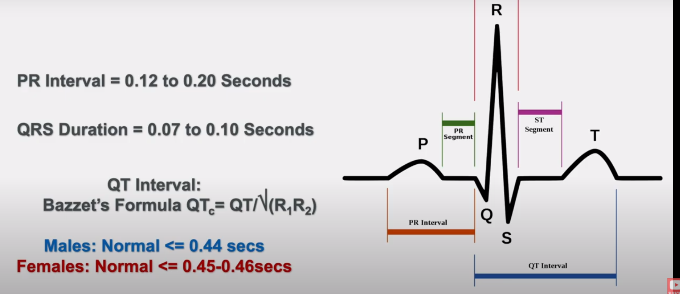

Slide 9
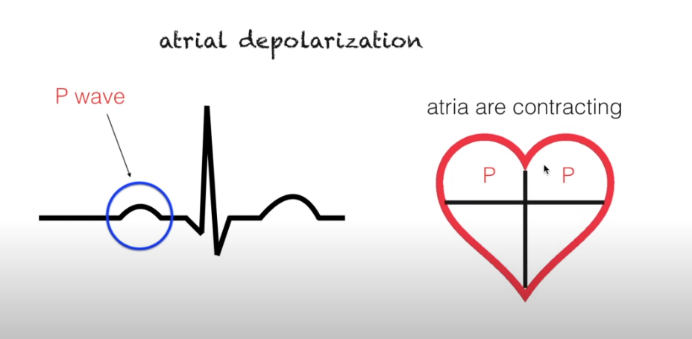

Slide 10
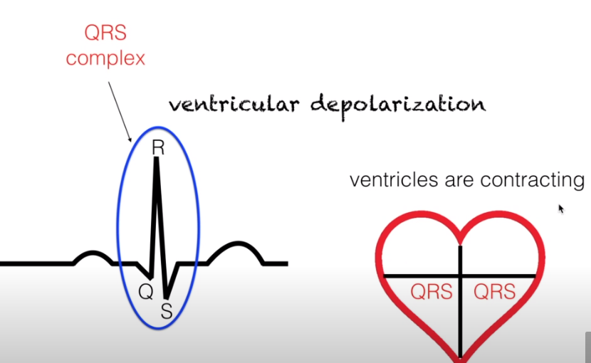

Slide 11
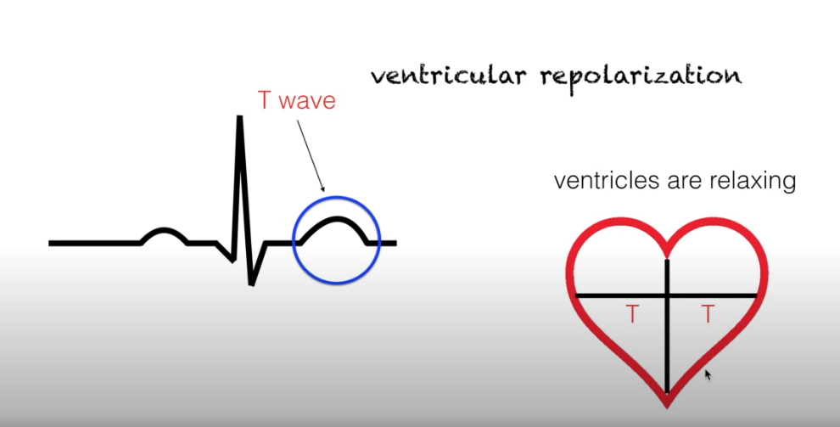

Slide 12
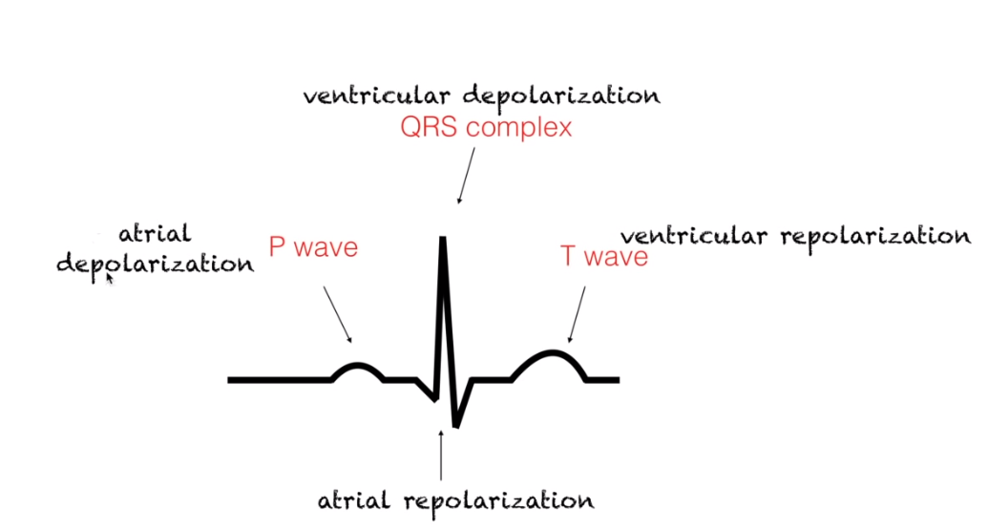

Slide 13
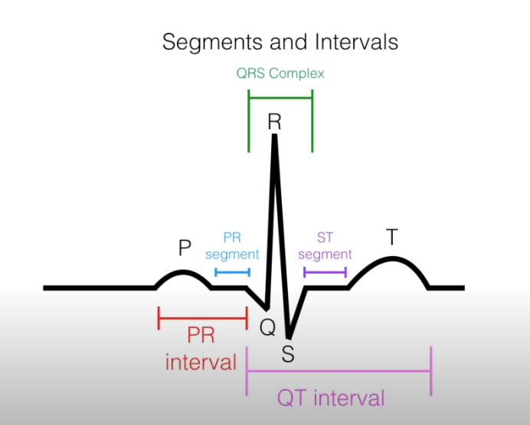

Slide 14
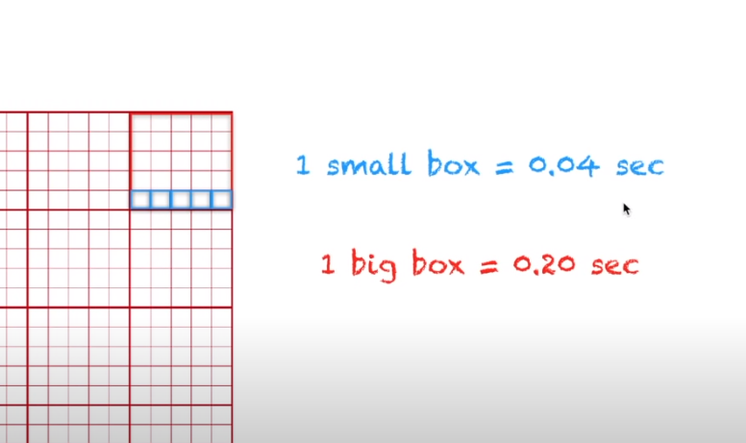

Slide 15
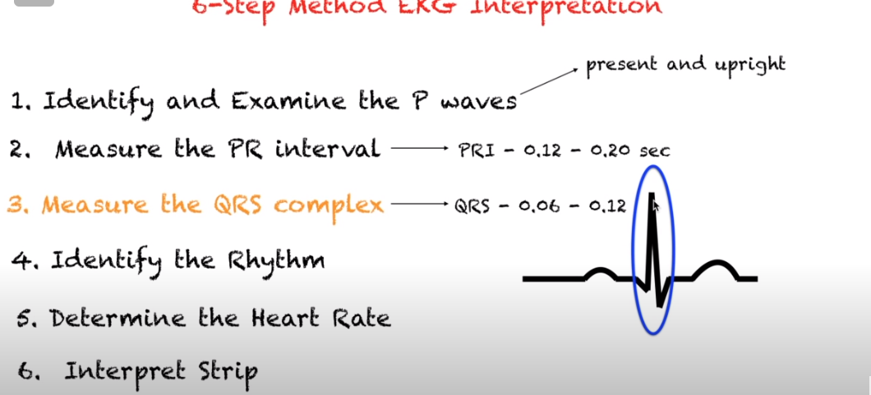

Slide 16
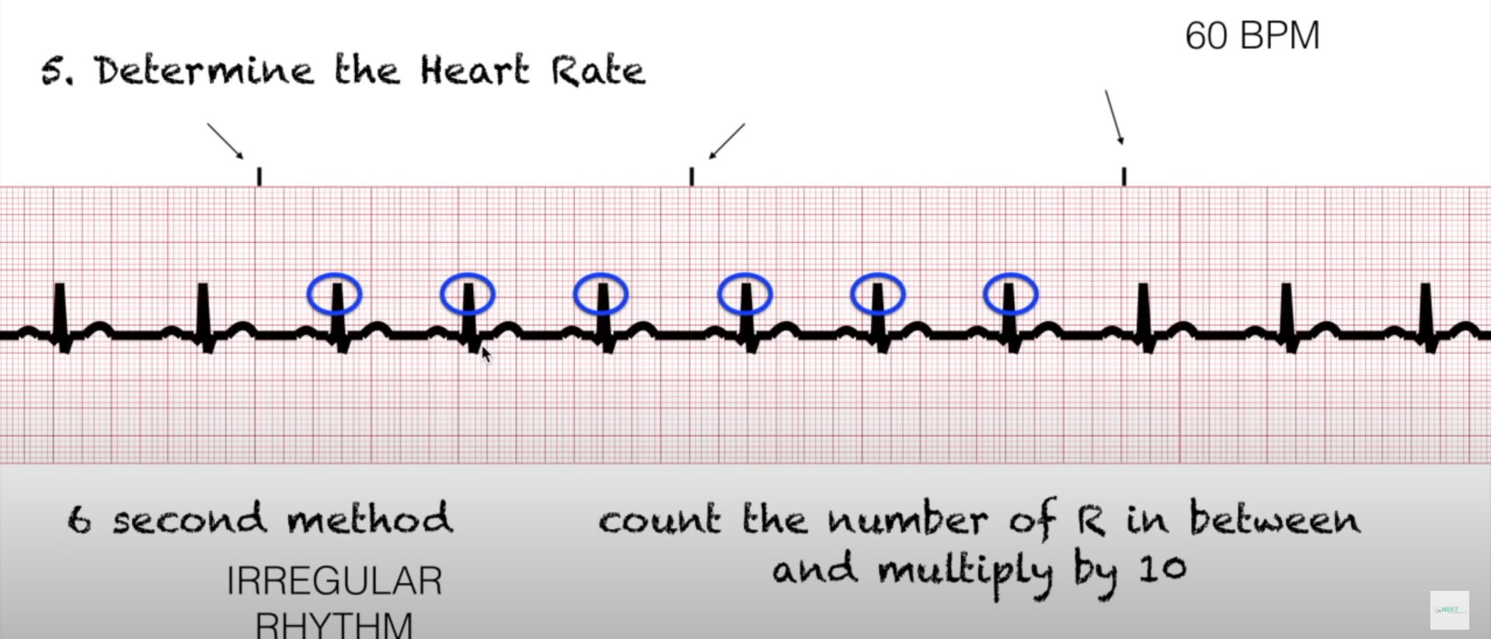

Slide 17
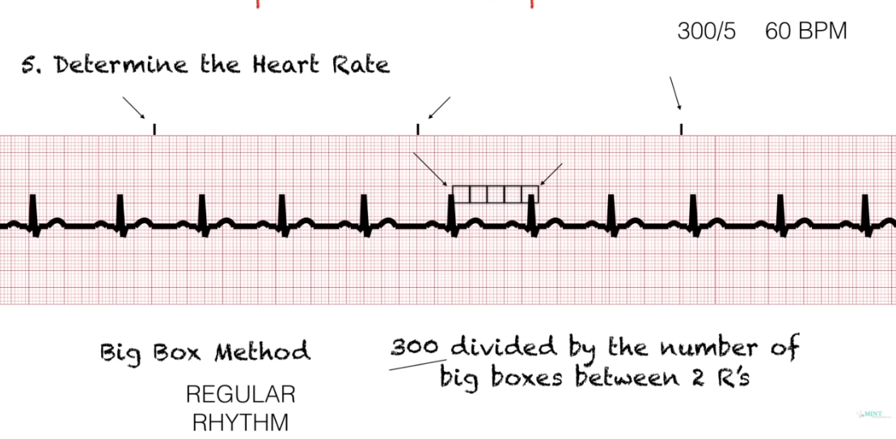

Slide 18
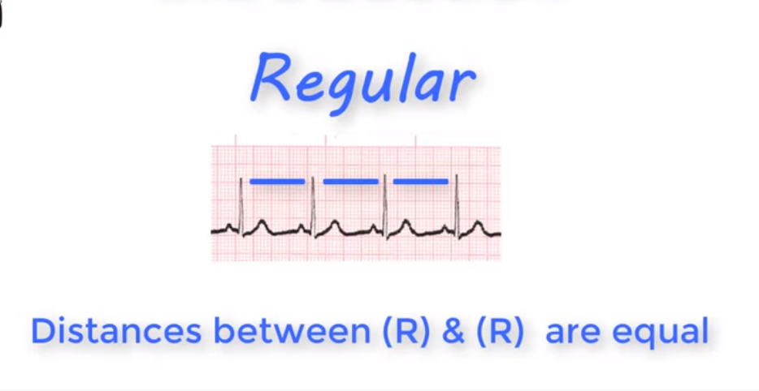
https://www.youtube.com/watch?v=kFfKe6XRqGg

Slide 19
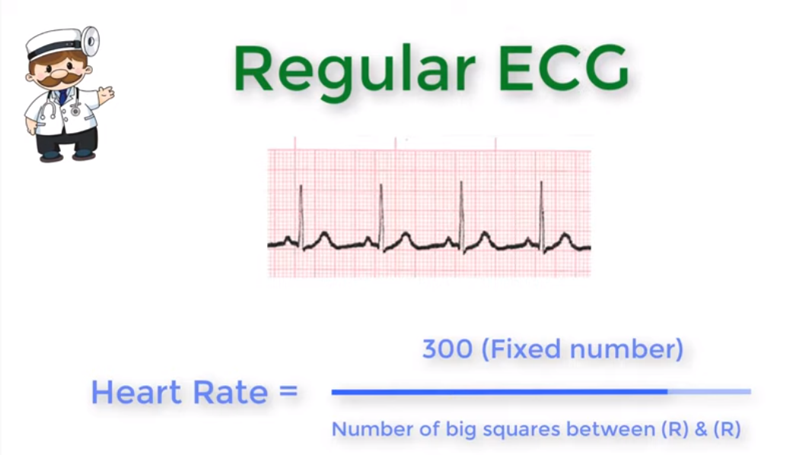

Slide 20
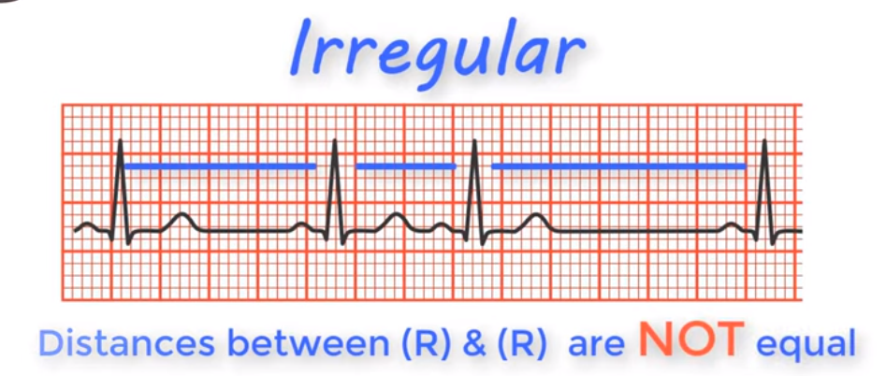

Slide 21
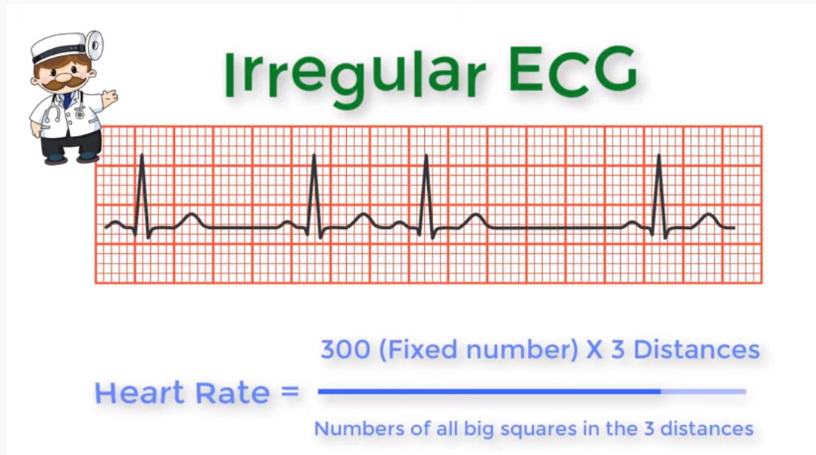

Slide 22
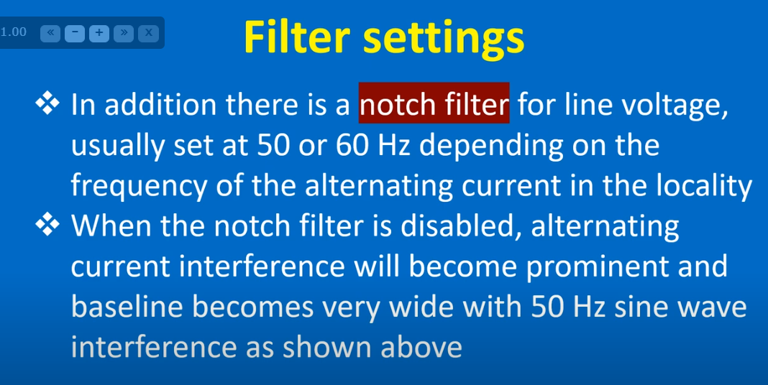

Slide 23
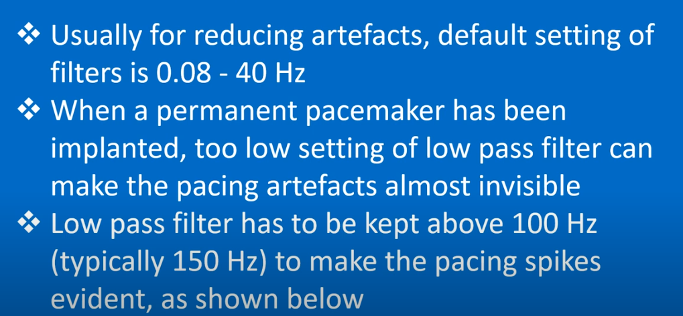

Slide 24
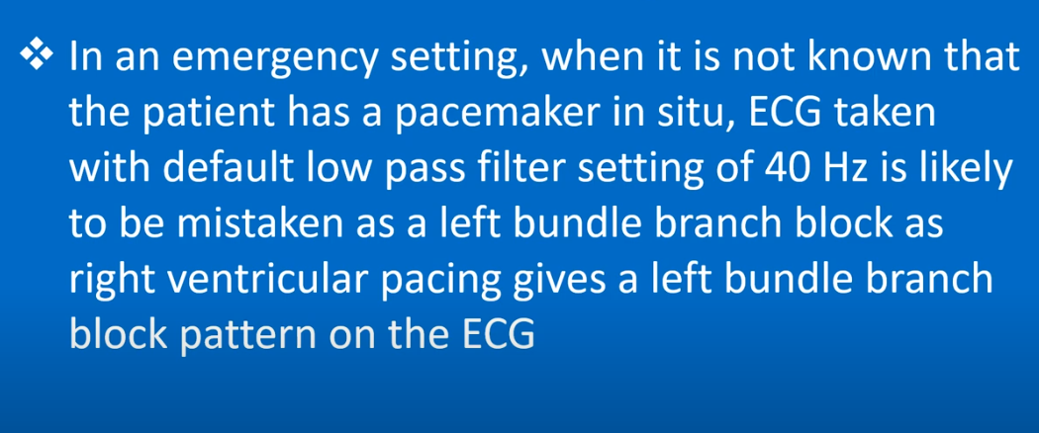

Slide 25
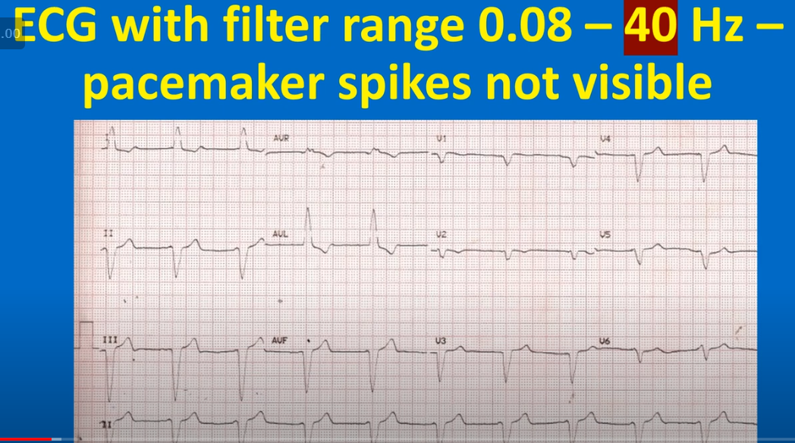

Slide 26
